Slide 1
CBEST
California Basic Educational Skills Test
Caren Bautista
Center for Careers in Teaching
California State University Fullerton

Slide 2
What is the CBEST?
The California Basic Educational Skills Test, or CBEST, is one of 7 ways to meet the CA Basic Skills Requirement
It is a four-hour exam divided into three different sections – a multiple choice Reading section, a multiple choice Mathematics section, and a Writing section with two essays.

Slide 3
Why take the cbest?
  You are applying for a CTC approved teacher preparation/credential program
  You are applying to be a day to day substitute –
  You are applying for a first teaching credential

Slide 4
Meet the Basic Skill Requirement
Examination | English Score Requirement | Math Score Requirement
CSU Early Assessment Program (EAP) | “College Ready” or “Exempt” | “College Ready” or “Exempt”
CSU Placement Exams (EPT and ELM) | Score of 151 or above | Score of 50 or above
College Board SAT | Score of 500 or above | Score of 550 or above
ACT | Score of 22 or above | Score of 23 or above
College Board Advanced Placement Examinations (AP) | Score of 3 or above on one of the following: AP English Language and Composition AP English Literature and Composition | Score of 3 or above on one of the following: AP Calculus AB AP Calculus BC AP Statistics
CSET Writing Skills | CSET Multiple Subject (all 3 subtests)
Notes:
Students taking the CSET: Multiple Subject may take the CSET: Writing Skills to meet the Basic Skill Requirement

Slide 5
When is the CBEST offered?
Paper-based testing ($41)is offered five to six times during the year. In 2015-2016, you can take the CBEST in the following months: September, December, February, April, and July.
Computer- based testing ($41+ $61)is available year-round by appointment only, Monday through Saturday (excluding holidays).

Slide 6
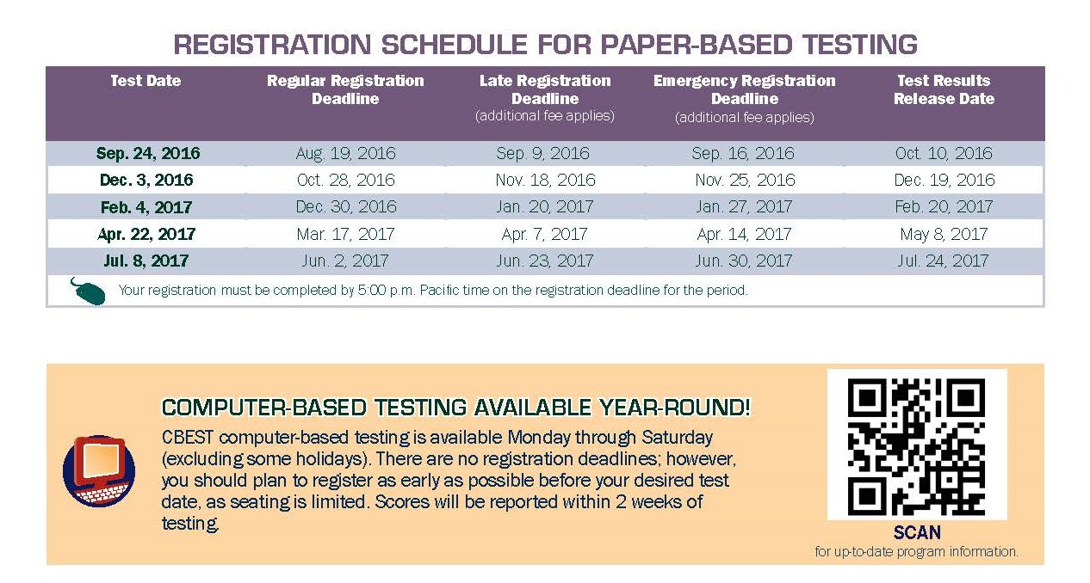
Paper-based testing
Downloaded from http://www.ctcexams.nesinc.com/PDF/CB_1617_Flyer.pdf

Slide 7
Taking and Passing the Test
You must pass all three sections:
Reading, Mathematics, and Writing.
Once you pass a particular section, you do not have to take that section again.
If you do not pass a section, you can register, pay the $41 fee and retake the entire test or just that one section. Note that you may not take the CBEST more than once in any 45–calendar-day period.
Retaking sections that you have already passed may help you reach the total score required to pass the CBEST.

Slide 8
Scoring the CBEST
Minimum Total Score = 123
Minimum Section Score = 41*
* However, with a total score of 123 or above, you can also pass with a minimum section score of 37
 | Example #1 | Example #2 | Example #3
Reading Score | 41 | 43 | 50
Writing Score | 41 | 43 | 50
Math Score | 41 | 37 | 30
Total Score | 123 | 123 | 130
Result | Pass | Pass | No Pass Re-take all or just math

Slide 9
CBEST Questions
Format of questions on the CBEST:
Section | Number of Questions
Reading | 50 (Multiple Choice)
Mathematics | 50 (Multiple Choice)
Writing | 2

Slide 10
The Reading Questions
What does it test?
  This section assess your ability to comprehend information presented in written passages, tables, and graphs
No outside knowledge is required!
Reading passages vary in length ranging from one or two sentences to 200 words
Questions will come from two major skill areas:
  Critical analysis and evaluation (40% of the questions)
  Comprehension and research skills (60% of the questions)

Slide 11
Read the passage below; then answer the question that follows.
The European settlers in the Americas were better armed that the native peoples, and more importantly, more resistant to the European diseases they carried with them. Influenza and smallpox were destined to kill far more than was simple firepower. Thus the Europeans prevailed against large numbers of native Americans and became successful exporters of tobacco.
Which of the following statements does not fit into the pattern of logic developed in the passage?
The Europeans were better armed.
The Europeans were more resistant to disease.
Influenza and smallpox killed more people that did simple firepower.
The Europeans prevailed against large numbers of native Americans.
The Europeans became successful exporters of tobacco.
Downloaded from www.ctcexams.nesinc.com

Slide 12
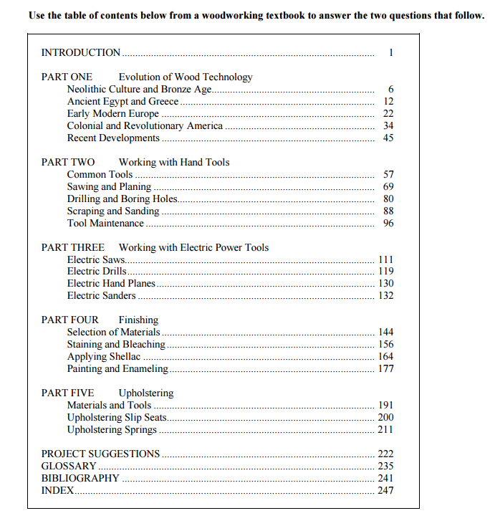
In which part of the book would information about sharpening and cleaning hand saws most likely be found?
Part One
Part Two
Part Three
Part Four
Part Five
A reader is looking for the technical definitions of cordwood and plywood. The reader could probably find this information most quickly and easily by looking first in which of the following sections of the book?
Part Two
Part Three
Project Suggestions
Glossary
Bibliography
Downloaded from www.ctcexams.nesinc.com

Slide 13
A Look at the Mathematics Section
What does it test?
  Brush up on your basics – arithmetic, measurements, introductory algebra and introductory geometry
Most of the questions are presented as word problems.

Slide 14
Major Math Skill Areas
35% of questions | Computation and problem solving
30% of questions | Estimation, measurement, and statistical principles
35% of questions | Numerical and graphic relationships

Slide 15
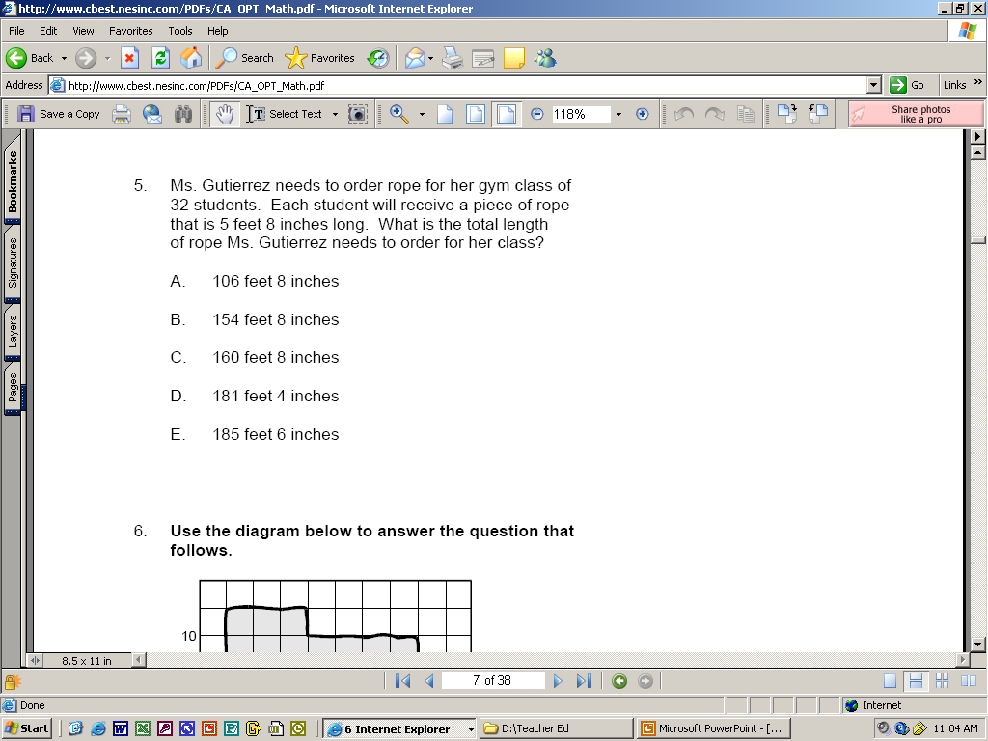
Sample Math Practice Exam
Information provided:
5 feet 8 in (length of each piece of rope); 32 students
Convert 5 feet 8 in. to # of inches
5 feet = 12 in x 5 = 60 inches + 8 inches = 68 inches
Multiply the # of inches by the # of students 68 x 32 = 2176 inches
Divide the number of inches by 12(inches in a foot)
  2176 ÷ 12=181 r4
Answer 181 feet 4 inches
Correct answer: D
Downloaded from www.ctcexams.nesinc.com

Slide 16
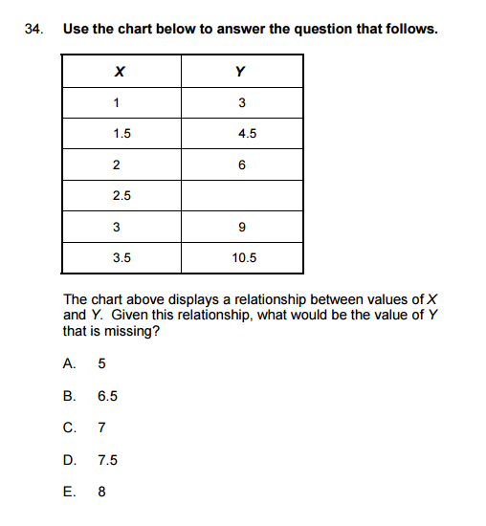
The relationship is:
X x3 =Y so
2.5 x3 = 7.5
Downloaded from www.ctcexams.nesinc.com

Slide 17
Peter works 38 hours per week and earns $7.25 per hour. His employer gives him a raise that increases his weekly gross pay to $307.80. What is the increase in Peter's weekly
gross pay?
A. $ 32.30
B. $ 34.70
C. $ 42.46
D. $275.50
E. $300.55
38 hours x $7.25 per hour = $275.50
$307.80 – $275.50 = $32.30

Slide 18
The Writing Section
2 essays –
Personal Experience - the “Experience” essay
Topics include reminiscences about people or past events, situations at home, school, or in the community, current events and issues, observations about the media, hobbies, personal successes and accomplishments, changes the writer would like to see made, career choices, and the like.
Explanatory/Analytic - the “Issue” essay
Calls on the writer to explain current issues and ideas, controversies, difficulties, or opinions.
Barron’s How to Prepare for the CBEST 5th ed.

Slide 19
How are the essays scored?
Rhetorical Force – the clarity with which the central idea or point of view is stated and maintained; the coherence of the discussion and the quality of the writer’s ideas.
Organization – the clarity of the writing and the logical sequence of the writer’s ideas.
Support and Development – the relevance, depth, and specificity of the supporting information.

Slide 20
How are the essays scored?
Usage – the extent to which the writing shows care and precision in word choice.
Structure and Conventions – the extent to which the writing is free of errors in syntax, paragraph structure, sentence structure, and mechanics (spelling, punctuation, and capitalization)
Appropriateness – the extent to which the writer addresses the topic and uses language and style appropriate to the given audience and purpose.

Slide 21
CBEST Writing Score Scale
Score | Score Point Description
4 (Pass) | A “4” is a well-formed writing sample that effectively communicates a whole message to the specified audience.
3 (Marginal Pass) | A “3” is an adequately formed writing sample that communicates a message to the specified audience.
2 (Marginal Fail) | A “2” is a partially formed writing sample that communicates a message to the specified audience.
1 (Fail) | A “1” is an inadequately formed writing sample that fails to communicate a message to the specified audience.

Slide 22
Tips for the Writing Section
Write only about the topics in the test booklet.
Address all the points presented in the topics.
Support generalizations with specific examples.
Read each topic and organize your thoughts before you begin writing.
Allocate your time wisely so that you can write about both topics.
Use a no.2 (soft lead) pencil to write your essays. (no mechanical pencils or pens allowed)
Write in your own words and do not paraphrase or copy any other work.

Slide 23
Tips for the Writing Section
Use smooth transitions that flow from one paragraph to another.
Develop the essay in an organized, logical sequence.
Use the correct mechanics of writing – including spelling, sentence structure, punctuation, and word usage.
  Spell-check and grammar check features are not available to paper-based or computer administered test takers.
  Multiple errors will lower your score, especially if they interfere with the reader’s ability to understand your essay.
The readers are professional graders, so avoid using trendy words, clichés, and jargon.

Slide 24
Essay Writing Pitfalls
The “I Believe” Syndrome
  When discussing your opinion on an issue, it is natural to state “I think” or “I believe”. However, the reader understands that the contents of the essay are your thoughts. Use the statement sparingly!
Big Word Syndrome
  Word choice can enhance the quality of your essay but it can also hinder the reader’s flow. Too many “big words” can detract from the expressed point of view; sometimes simple, direct words convey your ideas better.

Slide 25
Essay Writing Pitfalls
Redundancy Syndrome
  It is boring to read the same thought restated over and over again. Each sentence should add something unique to the essay.
Ugly Essay Syndrome
  Be respectful of your readers. CBEST scorers will read hundreds of essays. Imagine reading an essay that is messy, illegible, and missing proper indentations. Scorers will appreciate a well formatted, neatly written essay – your writing will take center stage, not your handwriting or formatting!

Slide 26
Personal Experience Sample Topic
Most students have had some type of difficulty in one course or another. In an essay to be read by an audience of educated adults, identify one class in which you faced difficulty as either a student or as a teacher, describe the difficulty, and how you handled the situation.
Notes:
Remember to ask yourself the why, what, how, when, and where questions to ensure that you are delivering a vivid picture of the event to the reader

Slide 27
Explanatory/Analytic Sample Topic
Ernest Hemingway once commented, “As you get older, it is harder to have heroes, but it is sort of necessary.” To what extent do you agree or disagree with his observation?
Support your opinion with specific examples.
Notes:
Successful essays are engaging, well organized, easy to read, and structurally sound.

Slide 28
Additional Tips
Structure your essays with multiple paragraphs
You may use blank space in the test booklet to make notes or prepare a rough draft for each essay. You will not be scored on pre-writing efforts
Spend an equal amount of time on each essay since they are each scored equally
In order to make sure you have enough space to write your essays:
  Do not skip lines or leave wide margins
  Do not write in excessively large print

Slide 29
Online Practice Test

Slide 30
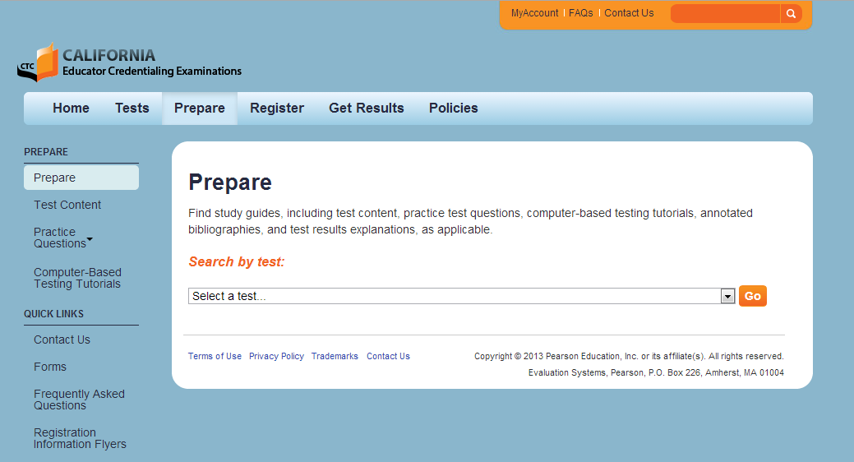
CBEST Test Preparation
http://www.ctcexams.nesinc.com/prepare.asp

Slide 31
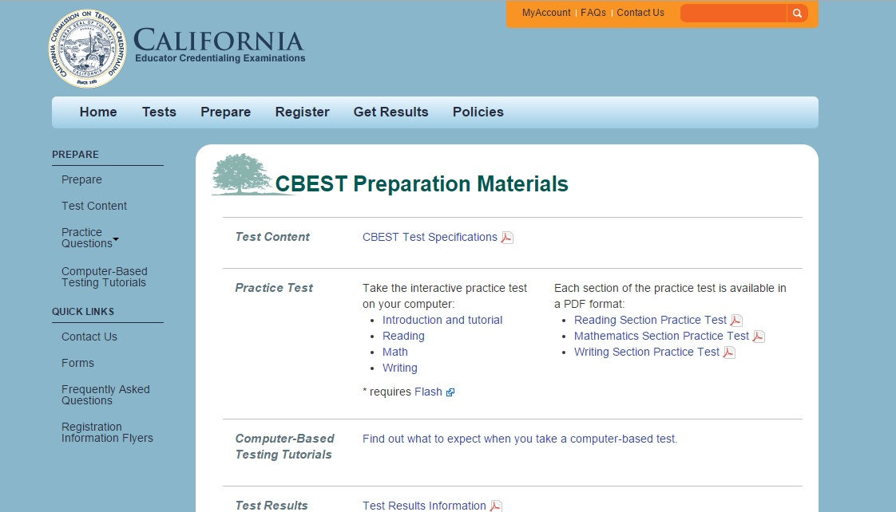
CBEST Test Preparation

Slide 32
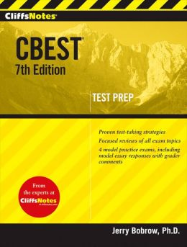
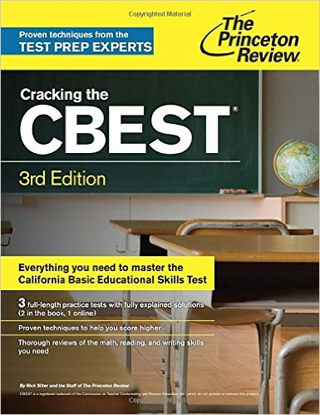
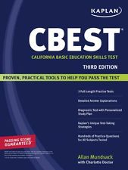
CBEST Test Preparation

Slide 33
For more information…
Visit the official CBEST website at
www.ctcexams.nesinc.com

Slide 34
Questions

Slide 35
CSET
California Subject Examinations for Teachers
Notes:
35

Slide 36
What is the CSET?
The California Subject Examination for Teachers, or CSET, is a timed exam divided into three to five different sections – each section has a specific content focus.
Notes:
36

Slide 37
Why Take the CSET?
California teaching credential candidates are required by law to verify their subject matter knowledge and competencies.

Slide 38
About the CSET
Quick Overview of
California Subject Examination for Teachers (CSET):
  Approximately $99-$134 per section
  Students may take 1-5 subtests during any of the scheduled test sessions.
  Taking the tests one at a time requires careful planning to ensure that all subtests are passed prior to the deadline for the credential program application.
  A passing exam score must be used for credentialing purposes within five years. The 5-year clock starts ticking with the passing of the first subtest.
  Test materials were developed using, in part, textbooks, California curriculum frameworks, California K–12 Student Academic Content Standards, Common Core State Standards as adopted by California, teacher education curricula, and CTC preparation program standards.

Slide 39
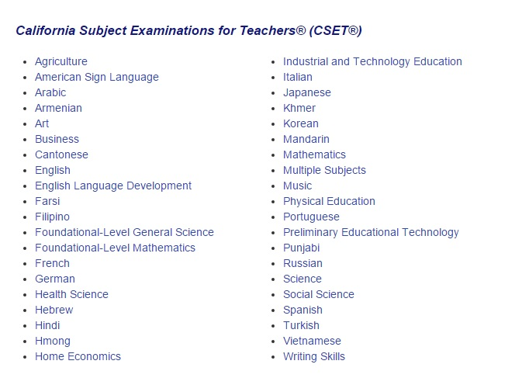
CSET Content Areas

Slide 40
When is the CSET offered?
All CSETs are administered as computer-based testing (except for American Sign Language)
Computer- based testing is available year-round by appointment.

Slide 41
CSET Test Format
Exam is divided into 3-5 subtests each with a specific focus
Questions are presented in two formats
  Multiple choice
  Constructed responses

Slide 42
SUBJECT MATTER COMPETENCY
California Subject Examination for Teachers:
Multiple Subjects (CSET)
Offered in three separate subtests which are divided by subject matter
  Language Arts, Literature & Social Science
  Math & Science
  Visual & Performing Arts, Physical Education, & Human Development
Each Subtest is $99 or $247 for all sections taken together

Slide 43
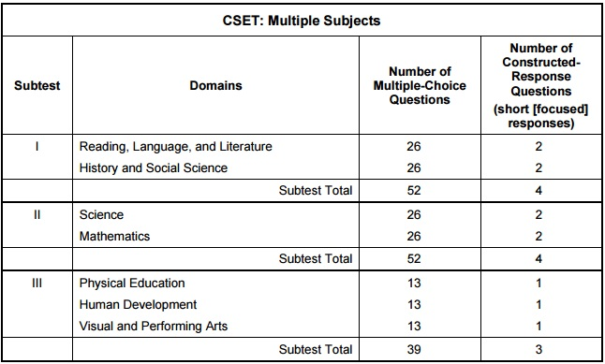
CSET: Multiple subjects format

Slide 44
SUBJECT MATTER COMPETENCY
California Subject Examination for Teachers:
Single Subject in Social Science (CSET)
Offered in three separate subtests which are divided by subject matter focus
  World History; World Geography
  US History; US Geography
  Civics; Economics; California History
Each Subtest is $99; $51-$104 other subjects

Slide 45
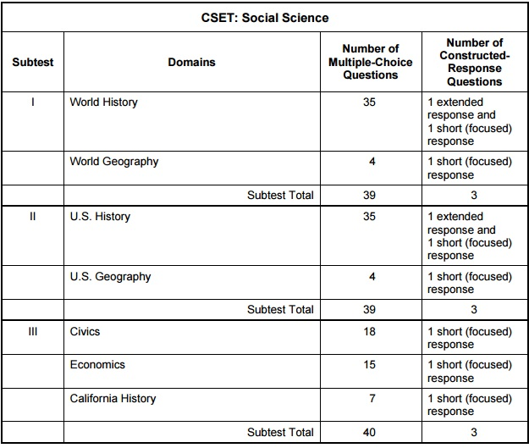
CSEt: Social science format

Slide 46
Constructed Response Questions
Constructed-response assignments are based on the following criteria:
PURPOSE:
the extent to which the response addresses the constructed-response assignment's charge in relation to relevant CSET content specifications
SUBJECT MATTER KNOWLEDGE:
the application of accurate subject matter knowledge as described in the relevant CSET content specifications

Slide 47
Constructed Response Questions
SUPPORT:
the appropriateness and quality of the supporting evidence in relation to relevant CSET content specifications
For some constructed-response assignments, scorers also focus on the extent to which a response fulfills a fourth performance characteristic.
DEPTH AND BREADTH OF UNDERSTANDING:
the degree to which the response demonstrates understanding of the relevant CSET subject matter requirements.

Slide 48
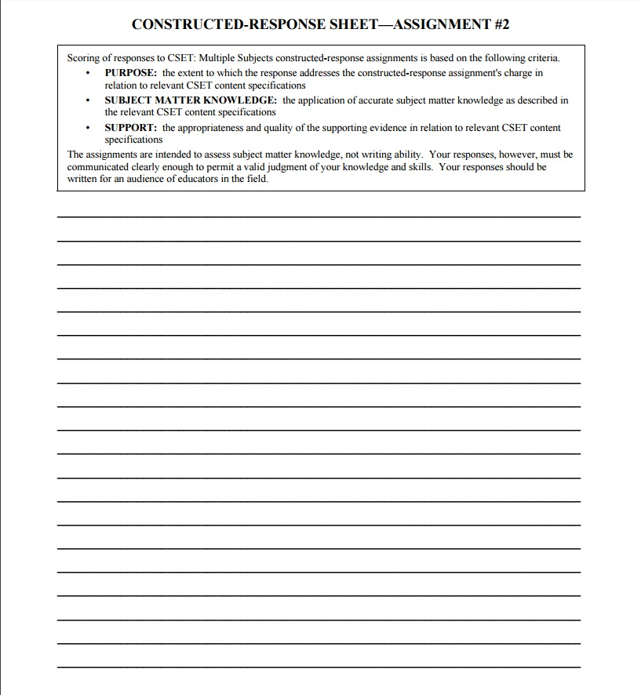
Constructed Response
Your response is limited to the lined area on the response sheet.
Focus on:
Purpose
Subject Matter Knowledge
Support

Slide 49
A MULTIPLE CHOICE QUESTION
Read the excerpt from a speech below; then answer the two questions that follow.
¹While Washington, D.C., does send a delegate to the U.S. House of Representatives, this official cannot cast a vote on the floor of the House of in committee, leaving D.C. residents without an effective voice in Congress. ²Like Americans living in every other part of the country, however, residents of the District pay federal income taxes. ³(Indeed, the per capita incline tax paid by D.C. residents is higher than in all but a handful of states.) ⁴It is a bitter irony that the only other U.S. citizens who are denied full voting rights are convicted felons. ⁵Some D.C. residents now compare their plight to that of pre-Revolutionary War colonists; the phrase “No taxation without representation” has become something of a local rallying cry.
6. Which of the following research questions would provide the most appropriate starting point for an objective investigation of issues raised in this excerpt?
Are there other respects in which D.C. residents lack full citizenship rights?
Are there any groups of citizens other than felons who are denied voting rights?
Why do D.C. residents pay relatively high per capita income taxes?
What arguments are raised by opponents of Congressional representation for D.C.?
5. Which sentence most strongly suggests that the speech is persuasive in its intent?
Sentence 1
Sentence 2
Sentence 4
Sentence 5

Slide 50
A MULTIPLE CHOICE QUESTION
5. Correct Response: C Most of the paragraph adopts a descriptive, neutral tone that might be found in a purely informational text. However, Sentence 4 reveals that the author has an opinion and is trying to persuade the reader to adopt it. In this sentence, the author points out that D.C. residents are being treated like felons and uses the phrase “bitter irony” to indicate disapproval of their treatment and to appeal to readers’ emotions. These are characteristics of persuasive writing.
6. Correct Response: D In the passage, the author provides the outline of an argument in favor of Congressional representation for Washington. D.C. A researcher who wishes to engage in an objective investigation of this issue should seek out and evaluate the arguments raised by those holding the opposite view. Presumably, these arguments would help to explain why Congressional representation has this far not been granted.

Slide 51
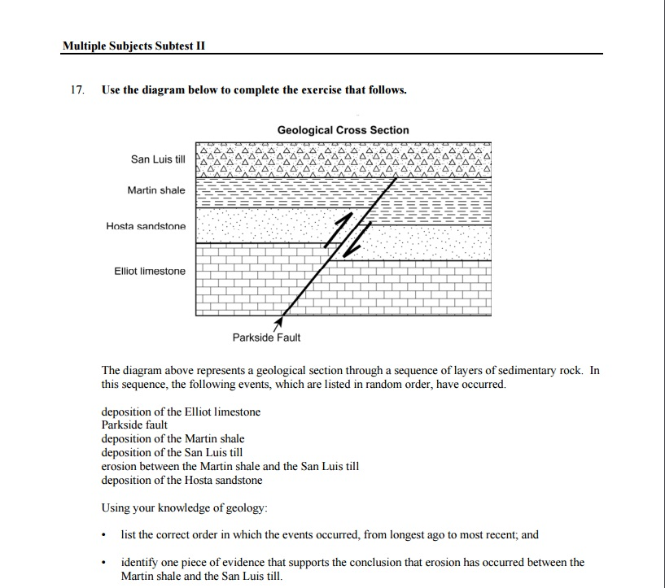
A Constructed response

Slide 52
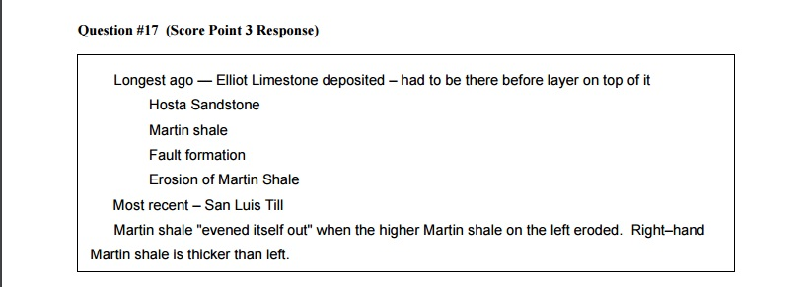
A Constructed response

Slide 53
How Does One Prepare for the CSET?
Become familiar with the CA Content Standards and Frameworks.
Choose a major that prepares you in subject matter knowledge.
Take classes that support your knowledge in your subject area(s).
Keep your notes, exams, and papers from all subject matter classes.

Slide 54
CSET Preparation Materials

Slide 55
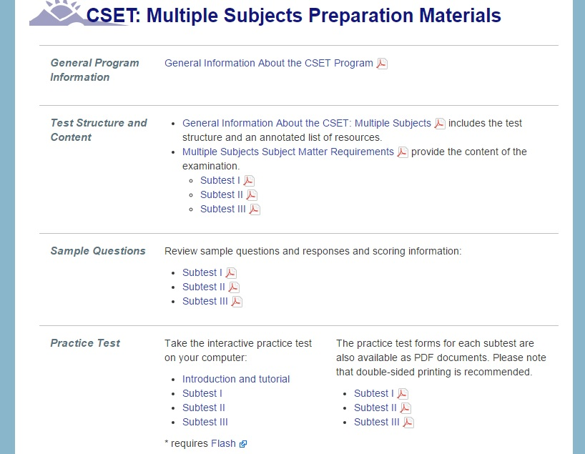
CSET Practice Test: Multiple Subjects

Slide 56
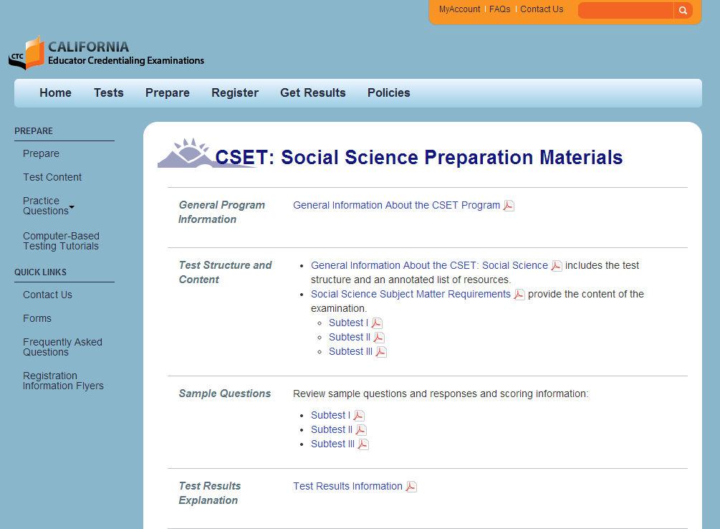
CSET Test Guides: Single Subjects

Slide 57
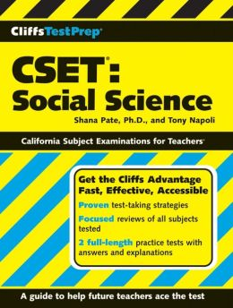
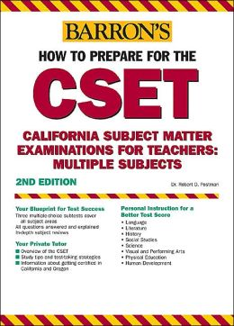
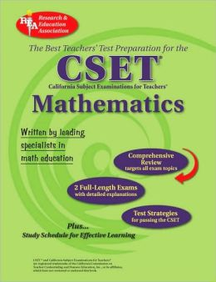
CSET Test Preparation

Slide 58
What GE classes best prepare me for the CSET?
Courses selected for the General Education Program can provide additional opportunities for establishing a knowledge base that will cover the subject matter standards underlying the CSET.
It is strongly recommend that students see their counselor frequently regarding GE , major, and credential program requirements.

Slide 59

How to Prepare as a Freshman/Sophomore
Ideally, preparation begins when you begin your college studies.
Select every general education class with an eye toward subject matter preparation.

Slide 60
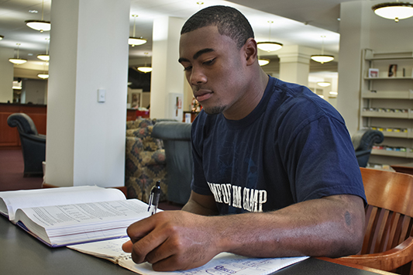
How to Prepare as a Junior/Senior
Juniors & seniors should select a major that will offer subject matter preparation.

Slide 61
RESOURCES FOR CSET PREP
Orange County Department of Education
Study guides and test advisement
http://www.ocde.us/Leadership/Pages/California-Subject-Examinations-for-Teachers-(CSET)-Test-Prep-Series.aspx
UC Irvine
Free online math & Science prep courses
http://ocw.uci.edu/collections/california_subject_examination_for_teachers__preparation_resources.html
CSET Test Guides
http://www.ctcexams.nesinc.com/prepare.asp

Slide 62
For More Information
log on to: http://www.ctcexams.nesinc.com/index.asp

Slide 63


Slide 64

Caren Bautista
STEM Teaching Coordinator
California State University Fullerton
Center for Careers in Teaching
(657) 278-3368
cbautista@fullerton.edu

